Slide 1

MHC-PMS
Task 1: First Analysis

Slide 2
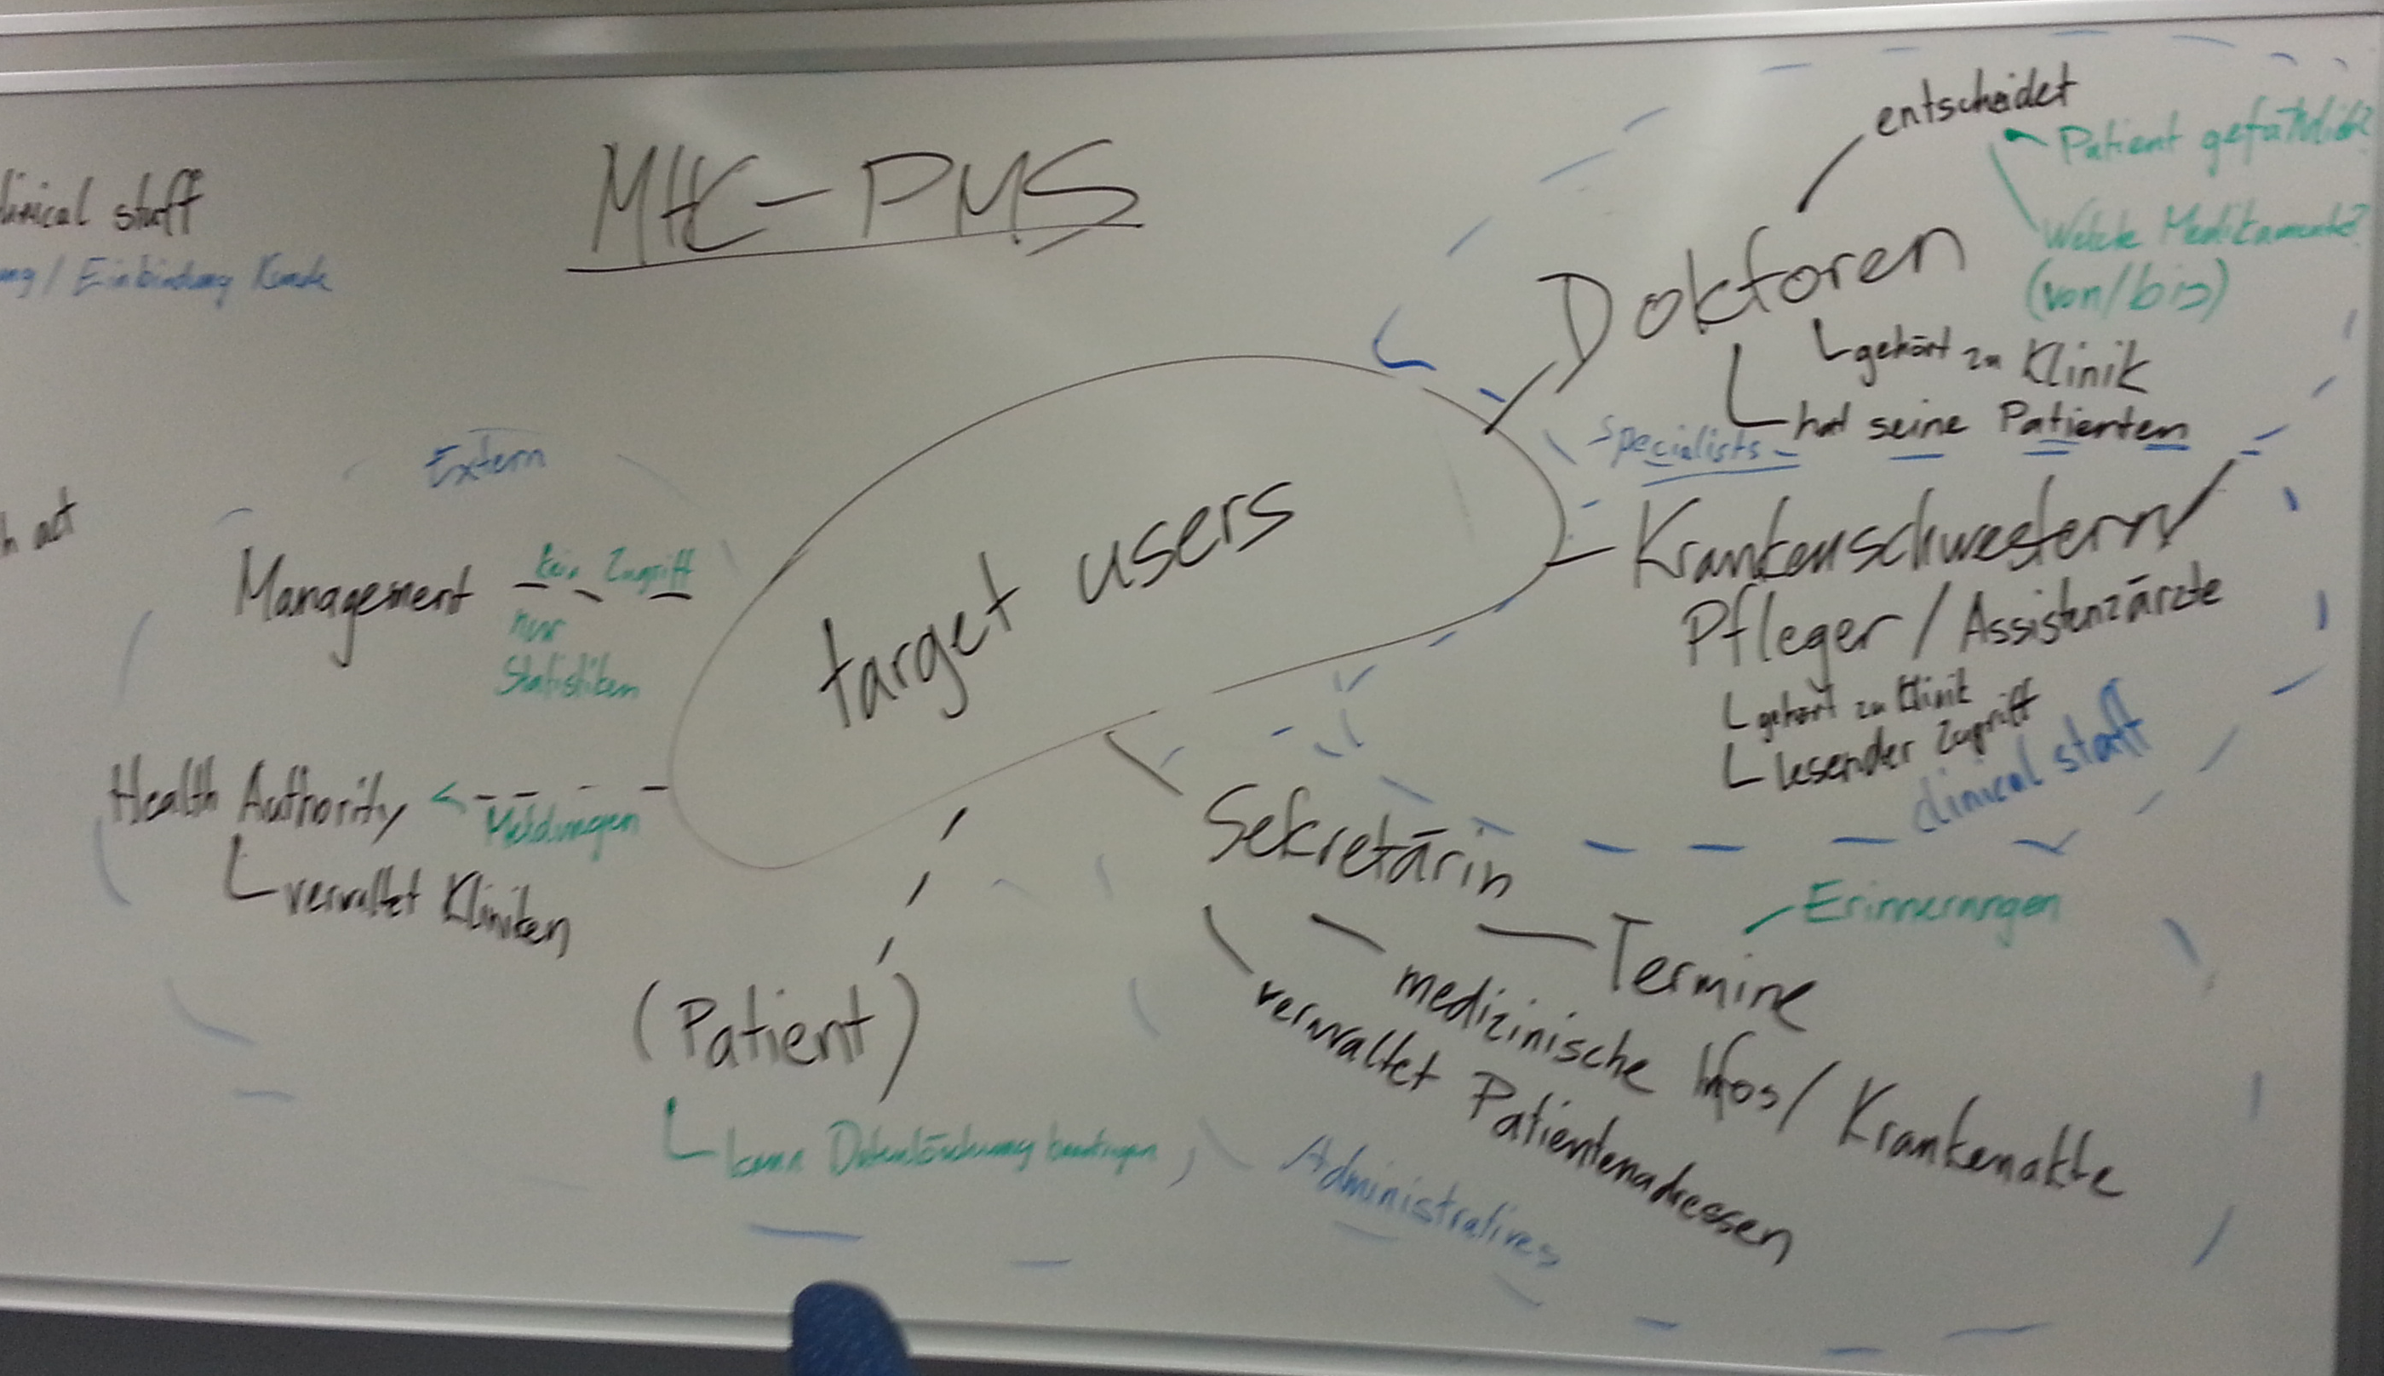
Target users

Slide 3
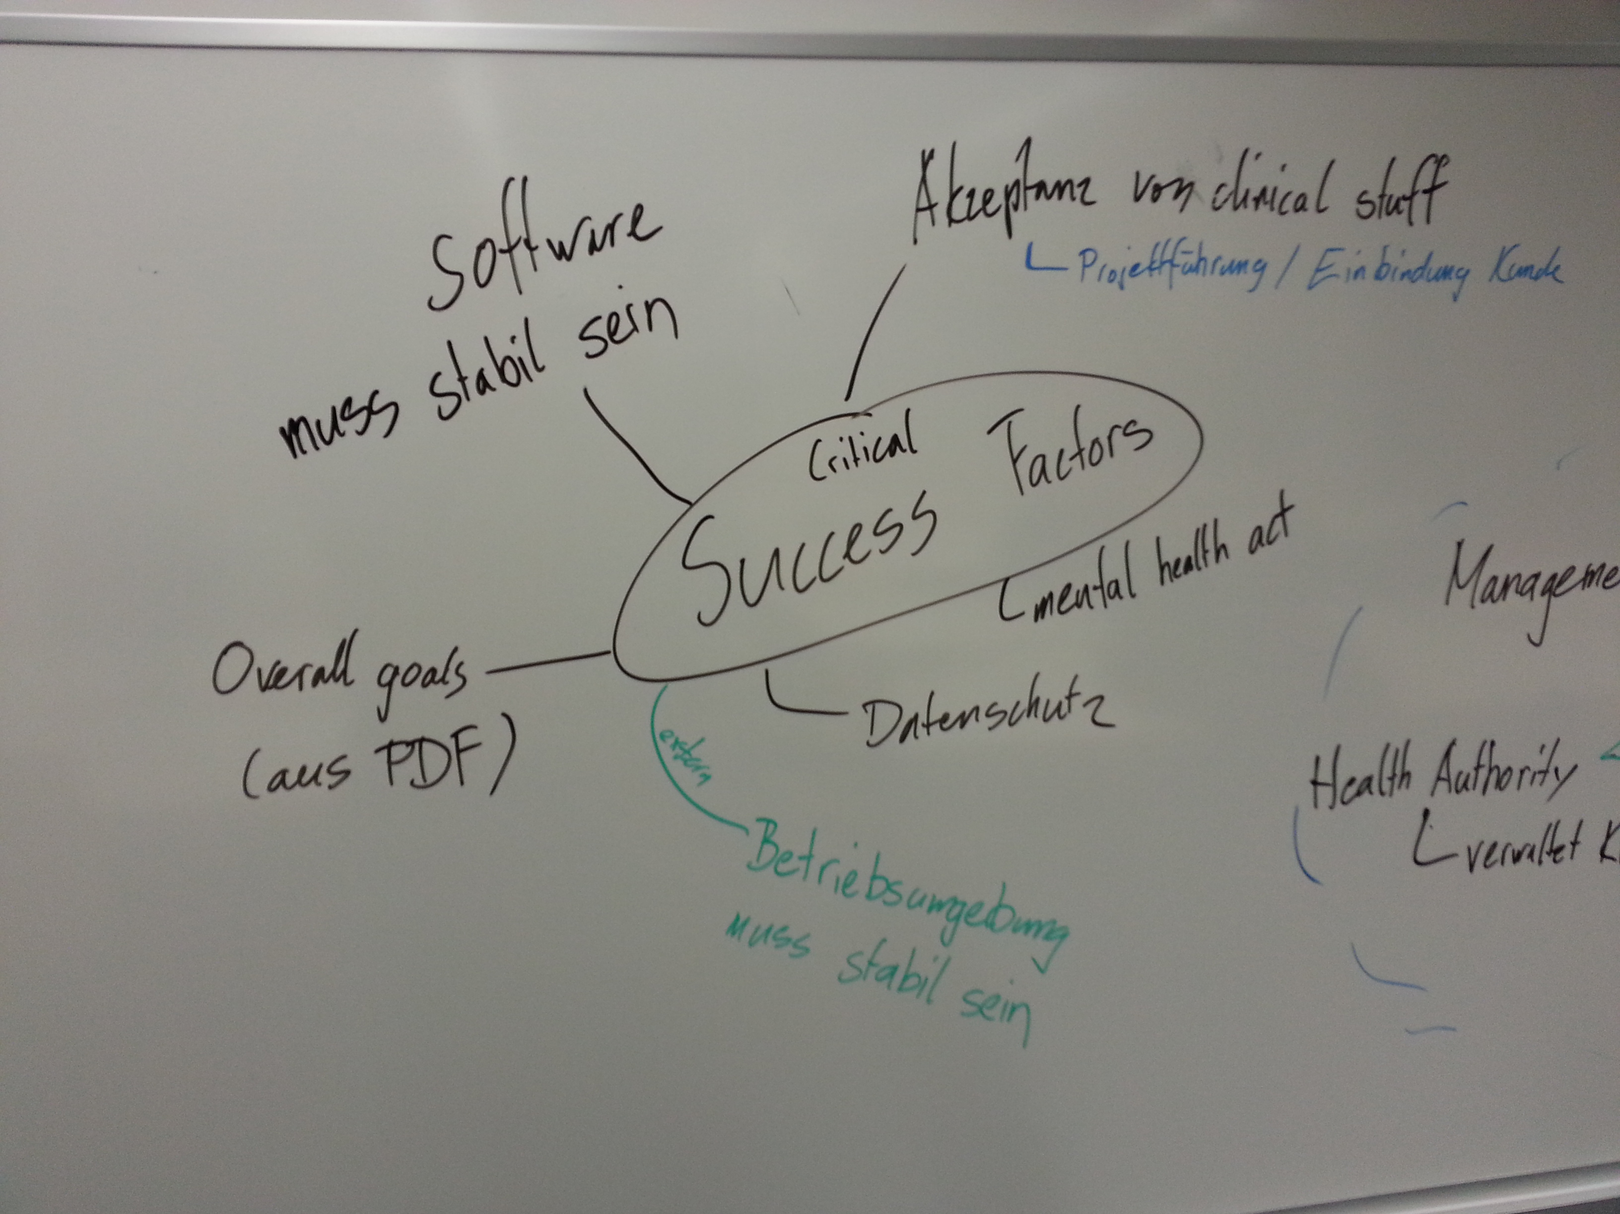
Key features
Manages: patient data, medical records, medication and prescriptions, clinics and personal
Generates: management statistics/reports
Informs: the health authority about dangerous patients

Slide 4
Critical success factors
Software must be stable and accepted by the customers
MHC-PMS complain with Mental health act and Data Protection Act
These two main features should be covered with the new System
provide medical staff with timely information to facilitate the treatment of patients.
generate management information that allows health service managers to assess performance against local and government targets.

Slide 5
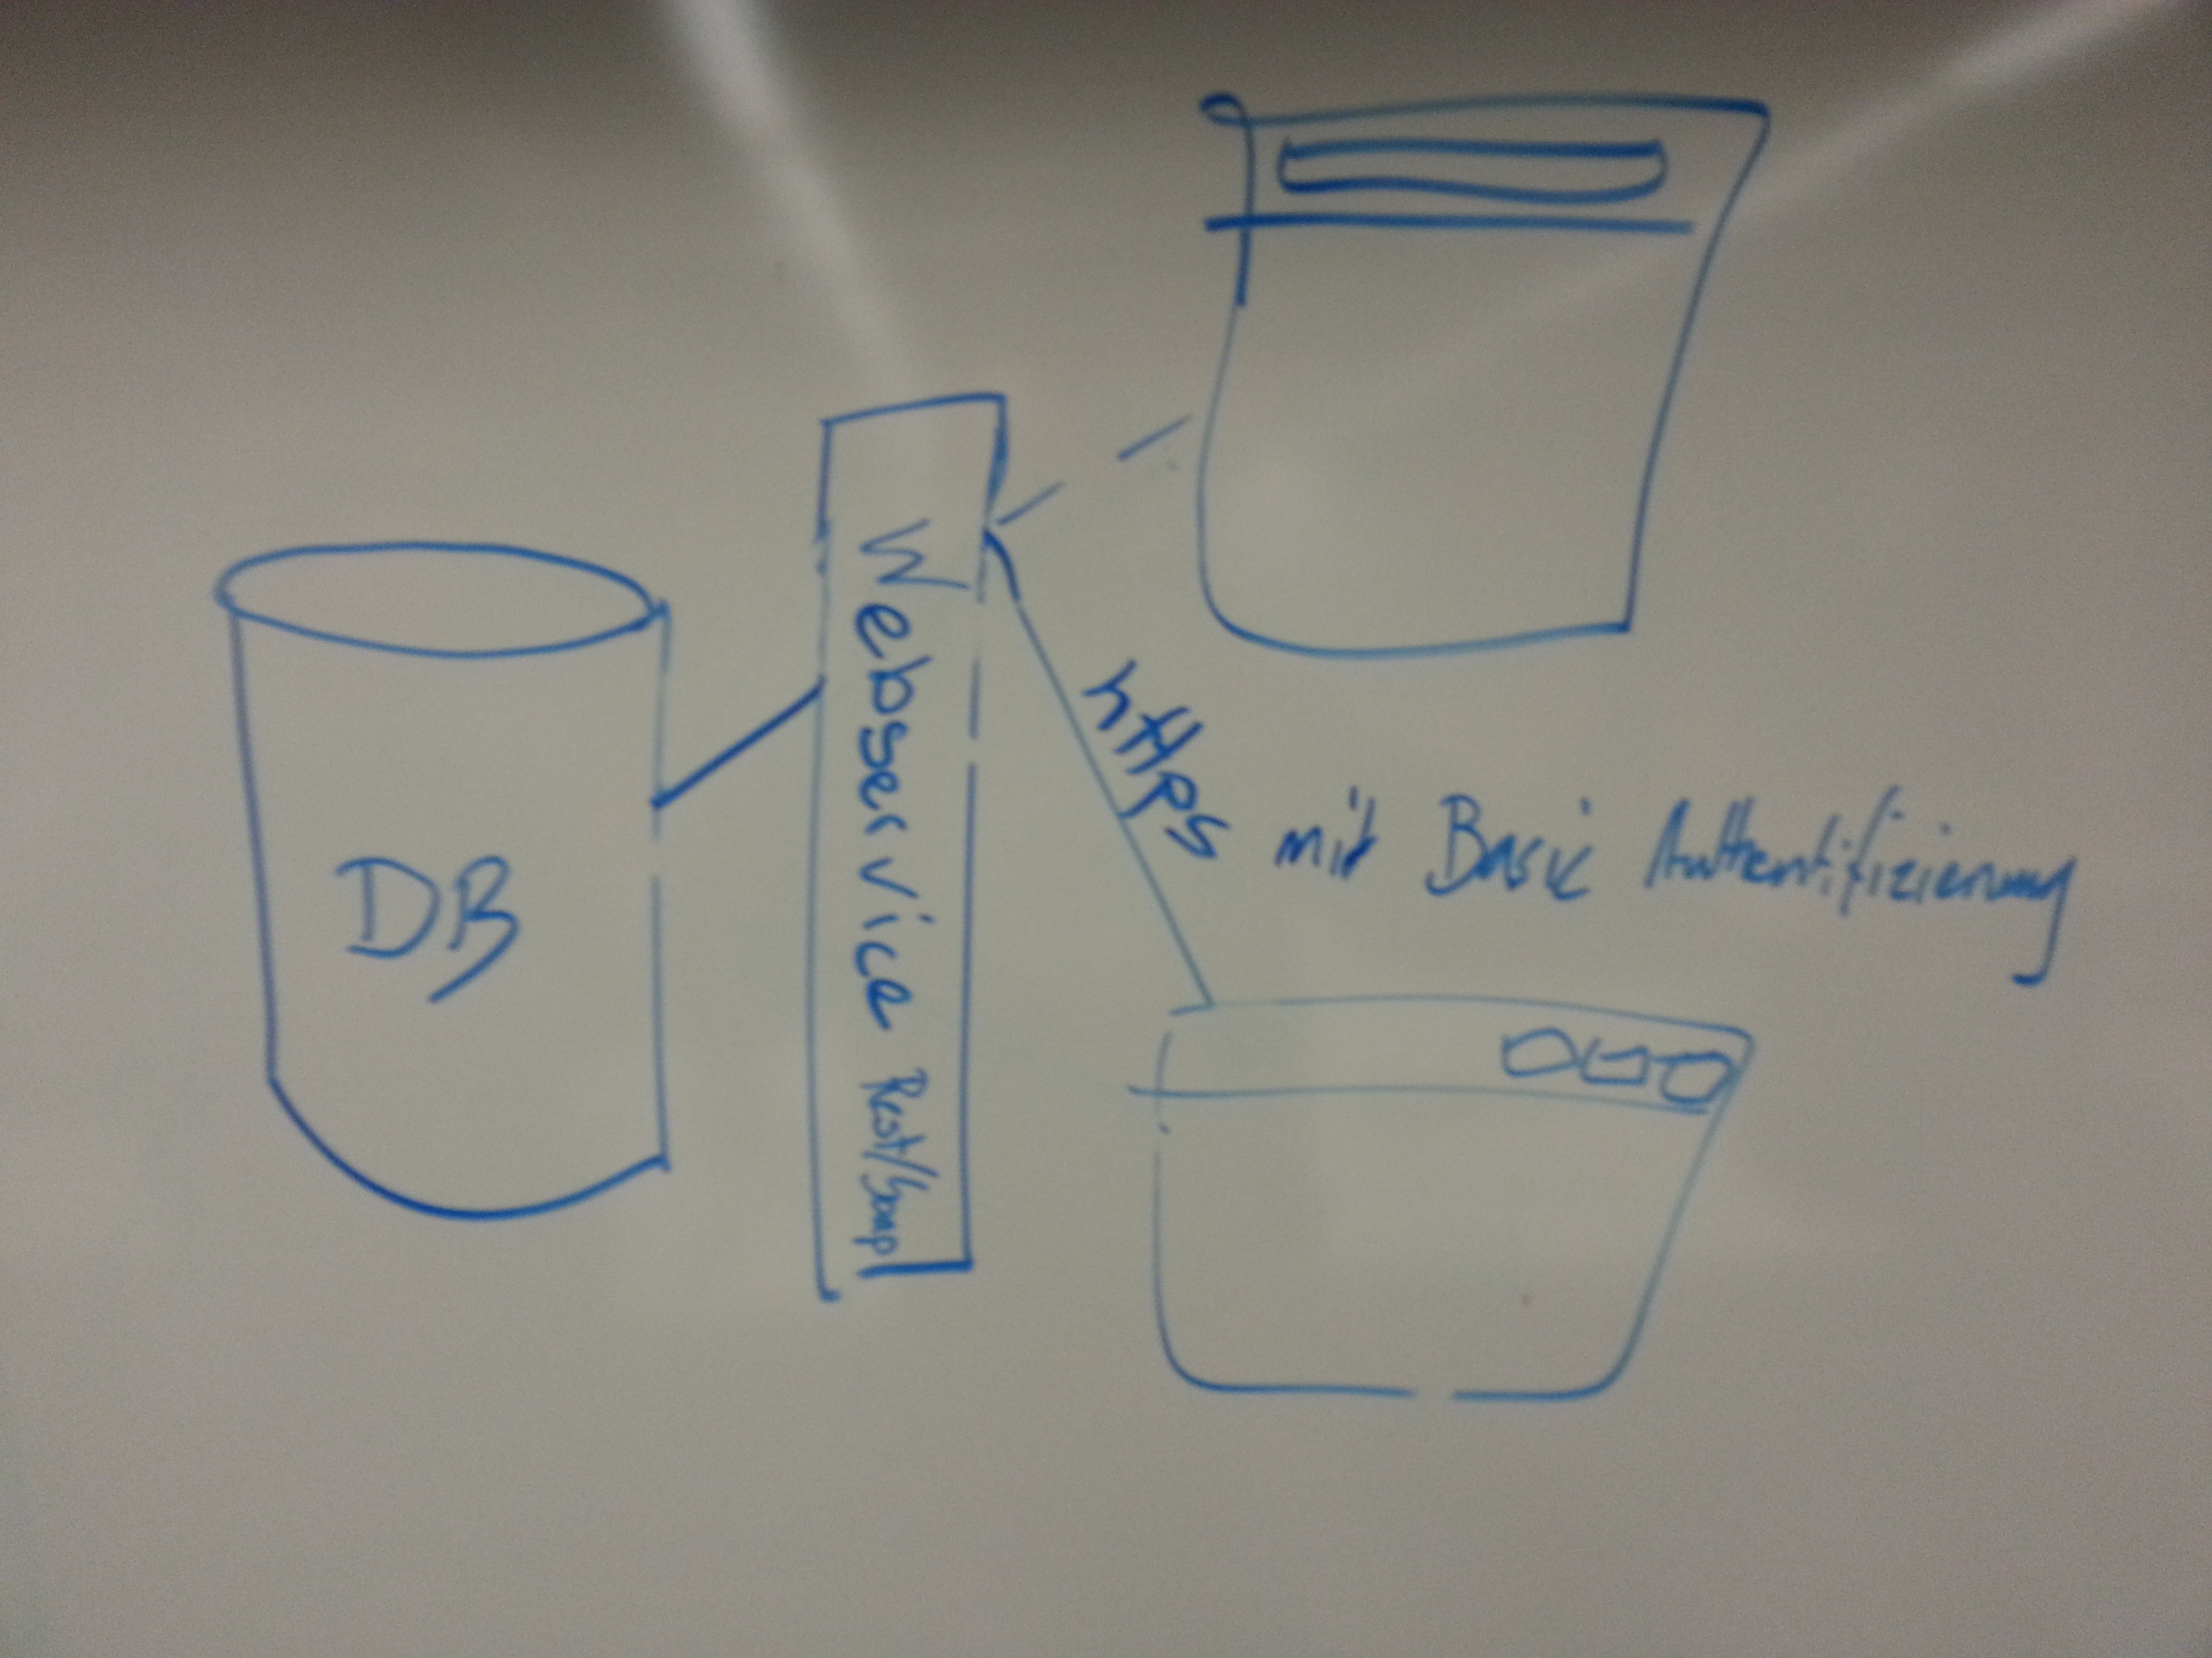
Potential system componets and high-level architecture

Slide 6
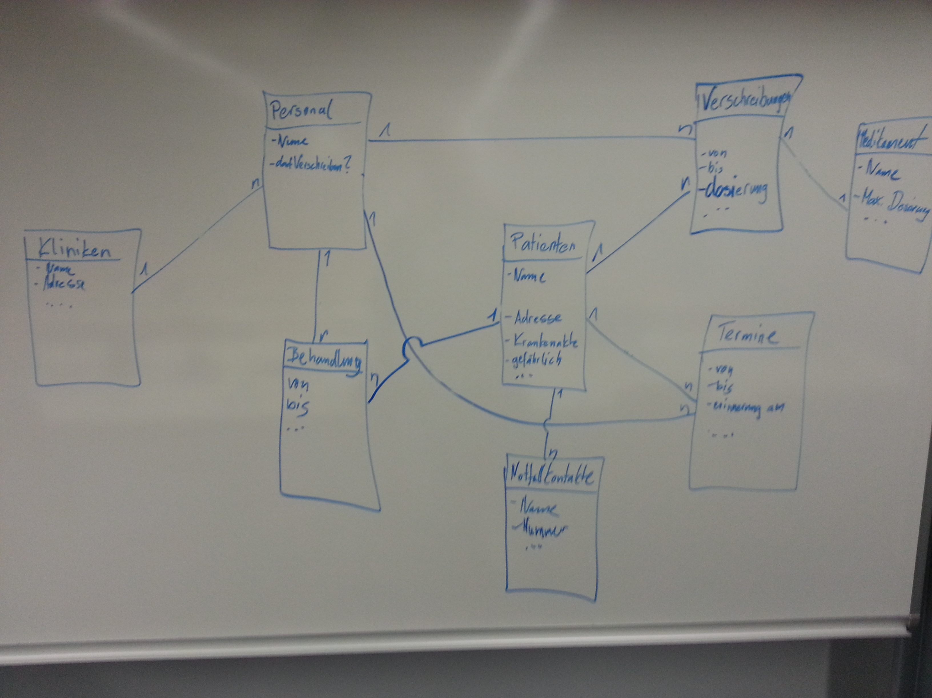
ERM (not yet needed…)

